Slide 1
Quiz Competition & Assessment Test
for
Career Counselling in Competitive Exams
Arranged By
Department of Mathematics
Mugberia Gangadhar Mahavidyalaya
Under DBT star college strengthening scheme, Govt. of India
Prepared by…
Twameka Tripathi, Gouri Sankar Mandal
PG 4th Sem Students 2022
under the supervision of …
Dr. Kalipada Maity
Associate Professor & HOD :: Dept of Mathematics
August 2022

Slide 2
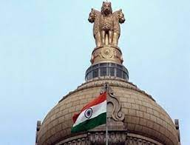
Union Public Service Commission
(UPSC) ( https://www.upsc.gov.in/ )
1) What is the full form of UPSC ?
a) Union Public Service Commission b) Union Public State Commission
c) United Public Service Commission d) none of these
2) Which recruitment commission conducts Civil Services Examination (CSE)?
a) UPSC b) RBI
c) SSC d) RRB
3) How many posts are there in UPSC-CSE ?
a) 23 b) 24
c) 28 d) 40
4) What is the minimum educational qualification required for appearing in UPSC?
a) Graduation b) Masters
c) P.hD d) None of these

Slide 3
5) What is the upper age limit for the civil service exam (General category)?
a) 32 b) 37
c) 35 d) 28
6) which type of organization UPSC is ?
a) Constitutional Body b) Non statutory body
c) Non-Constitutional body d) quasi-judicial body
7) Which service does not include in UPSC-CSE?
a) IAS b) IPS
c) IRS d) Banking
8) How many exams conducted by UPSC?
a) 10 b) 9
c) 11 d) 5
9) When did the form fill-up process start for civil service?
a) February b) March
c) January d) April

Slide 4
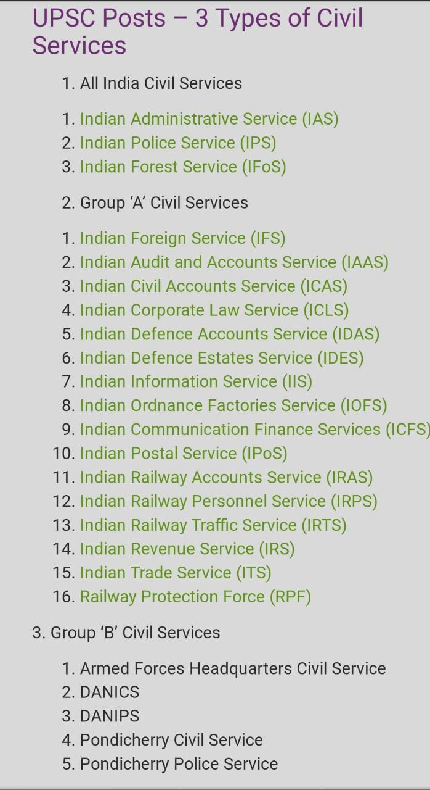
**List of 24 services through UPSC-CSE
** 3 stage of UPSC-CSE exam
(1) Preliminary Exam (Objective Test)
(2) Main Exam (Written Test)
(3) Personality Test (Interview)
** Total Marks (prelims+mains+interview)
(200+1750+275)
= 200+2025

Slide 5
Prelims
Mains
Paper | Marks | Time
Paper-1 | 200 | 2 Hours
Paper-2 (qualifying)(33%) | 200 | 2 Hours
Paper | Name of the Paper | Nature of Paper | Marks | Time
Paper-A | Compulsory Indian Language | QUALIFYING NATURE | 300 | 3 Hours
Paper-B | English |  | 300 | 3 Hours
Paper-I | ESSAY | MERIT RANKING NATURE | 250 | 3 Hours
Paper-II | General Studies I |  | 250 | 3 Hours
Paper-III | General Studies II |  | 250 | 3 Hours
Paper-IV | General Studies III |  | 250 | 3 Hours
Paper-V | General Studies IV |  | 250 | 3 Hours
Paper-VI | Optional Paper I |  | 250 | 3 Hours
Paper-VII | Optional Paper II |  | 250 | 3 Hours
Total |  |  | 1750

Slide 6
10) What is the full form of CAPF ?
a) Central Armed Police Force b) Central Armed Public Force
c) Central Artificial Police Force d) None of these
11) The CAPF examination is conducted to recruit Assistant Commandant(AC) which
is a
a) Group C service b) Group B service
c) Group A service d) Group D service
12) The upper age limit of UPSC-CAPF AC exam is
a) 27 years b) 25 years
c) 28 years d) 30 years
13) How many stages are there in UPSC CAPF AC exam ?
a) 3 b) 2
c) 4 d) 1
14) When UPSC CAPF AC exam conducted ?
a) August b) September
c) April d) June

Slide 7
15) How many forces are there in CAPF ?
a) 7 b) 8
c) 5 d) 6
16) What is the full form of CDS ?
a) Combined Defence Services b) Central Defence System
c) Control Defence System d) None of these
17) Which advisory body conducts CDS exam?
a) UPSC b) Self organisation
c) IMA c) Indian navy
18) How many times the CDS exam conducted in a year ?
a) one b) two
c) three d) four
19) How many services are offered through CDS exam ?
a) 5 b) 3
c) 4 d) 2
**CDS exam conducted for recruitment of Commissioned Officers in the Indian Military Academy(IMA), Officers Training Academy(OTA), Indian Naval Academy (INA)and Indian Air Force Academy(IAF).

Slide 8
20) How many stages are there in UPSC CDS exam ?
a) 3 b) 2 (written exam and SSB Interview)
c) 4 d) 1
21) Does Indian Forest Service (IFoS) belong to All India service ?
a) Yes b) No
22) Eligibility for CDS age limit (GS category)
a) below 25 years b) above 25 years
c) max 22 years d) 30 years
23) Which of the following service doesn't belong to All India services ?
a) IAS b) IPS
c) IRS d) IFoS
24) How many papers are there in UPSC-CSE prelims ?
a) 2 b) 3
c) 1 d) 4
25) How many optional subjects are offered by UPSC?
a) 47 b) 48
c) 45 d) 44

Slide 9
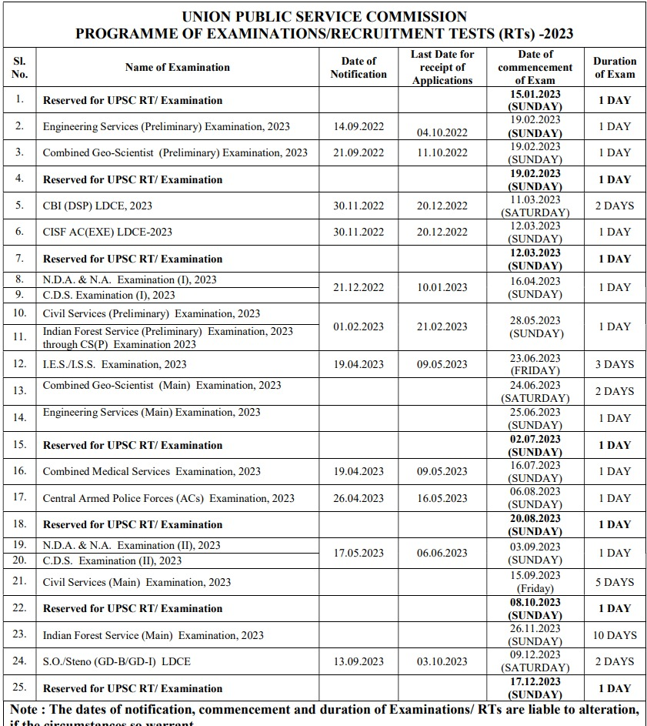
UPSC calendar for 2023

Slide 10

Staff Selection Commission
1) Staff Selection Commission - Combined
Graduated Level Examination ( SSC-CGL)
( https://ssc.nic.in/Portal/apply )
( https://ssc.nic.in/Portal/apply )
26) Which commission conducts SSC-CGL exam ?
a) Staff Selection Commission b) School Service Commission
c) State Service Commission d) None of these
27) Which type of officers are recruited in various posts in top ministries, departments and organizations of Government of India through SSC-CGL exam?
a) Group-A b) Group-B & Group-C
c) Only Group-B d) Group-D
28) The Staff Selection Commission was established in
a) 1978 b) 1975
c) 1970 d) 1974

Slide 11
SSC CGL Educational Qualification
Post | Educational Qualification
Statistical Investigator- Grade B | Bachelor’s Degree from any recognized University with a minimum of 60% in Mathematics in Class 12th OR Bachelor’s Degree in any discipline with Statistics as one of the subjects in graduation
Assistant Audit Officer (Gazetted Post )* | Bachelor’s Degree in any subject from a recognized University. OR CA/CS/MBA/Cost &Management Accountant/ Masters Commerce/Masters in Business Studies
Compiler | Bachelor’s Degree from any recognized University or Institution And, Candidates must have studied either Economics/Statistics/Mathematics as a compulsory or as an elective subject.
Assistant Section Officer | Bachelor’s Degree from a recognized University/Institute And, Candidates must also qualify in the Computer Proficiency Test
All other posts | Bachelor’s Degree in any discipline from a recognized University or Institute

Slide 12
SSC CGL Age limit for various posts
29) The SSC CGL Exam is conducted in how many stages ?
a) 3 b) 4
c) 2 c) 5
30) The age limit of SSC-CGL for different posts are in between
a) 18-32 years b) 22-32 years
c) 25-30 years d) 18-30 years
SSC CGL Age limit | Post
18-30 years | Assistant, Inspector
18-30 years | Assistant Section Officer, Assistant, Auditor, Sub-Inspector, Junior Accountant, Tax Assistant, Assistant Account Officer, Upper Division Clerk
Up to 30 years | Sub Inspector, Assistant Enforcement Officer
Up to 32 years | Junior Statistical Investigator
Not exceeding 30 years | Assistant Audit Officer, Assistant Account Officer, Inspector of Central Excise, Assistant Enforcement Officer, Assistant Section Officer, Inspector of Income Tax

Slide 13
SSC CGL Age limit to apply for various Departments is as follows
SSC CGL Age Limit | Department
20-30 years | Central Secretariat Service
Not exceeding 30 years | Intelligence Bureau
20-30 years | Ministry of Railway
20-30 years | Ministry of External Affairs
20-30 years | AFHQ
Not exceeding 30 years | CBDT
Up to 30 years | Directorate of Enforcement, Department of Revenue
20-30 years | Central Bureau of Investigation
Not exceeding 30 years | Officers under CAG
Up to 30 years | National Investigation Agency
Up to 32 years | M/O Statistics of Prog , & Implementation

Slide 14
SSC CGL Exam pattern
Tier | Subject | Number of Questions | Maximum Marks | Time allowed
Tier-I | General Intelligence and Reasoning | 25 | 50 | 60 Minutes (Total) For VH/ OH (afflicted with Cerebral Palsy/ deformity in writing hand- Pl 80 Minutes
 | General Awareness | 25 | 50
 | Quantitative Aptitude | 25 | 50
 | English Comprehension | 25 | 50
Tier-II | Paper-I: Quantitative Abilities | 100 | 200 | 120Minutes For VH/ OH (afflicted with Cerebral Palsy/ deformity in writing hand- 160 Minutes
 | Paper-II: English Language and Comprehension | 200 | 200
 | Paper-III: Statistics | 100 | 200
 | Paper-IV: General Studies (Finance and Economics) | 100 | 200
Tier-III | Descriptive Paper in Hindi/English( Essay, Letter, applications, precis) | _ | 100 | 60 Minutes For VH/ OH (afflicted with Cerebral Palsy/ deformity in writing hand- 80 Minutes

Slide 15


2) Staff Selection Commission Combined Higher Secondary Level ( SSC CHSL)
( https://ssc.nic.in/ )
( https://byjus.com/ssc-exams/ssc-chsl-eligibility/ )
The exam is held to recruit the Junior Secretariat Assistant (JSA), Lower Divisional Clerk (LDC), Sorting Assistant (SA), Data Entry Operator (Grade A & DEO).
Age limit - 18 to 27 years
Educational Qualification - 10+2 passed
Exam Pattern | Subjects | Total Marks | Time (Mins)
Tier – I | Quantitative Aptitude, English, General Awareness, General Intelligence | 200 | 60
Tier – II | Letter/Application Writing, Essay Writing | 100 | 120
Tier – III | Skill Test/ Speed Typing Test adjudged on the correct entry of data

Slide 16
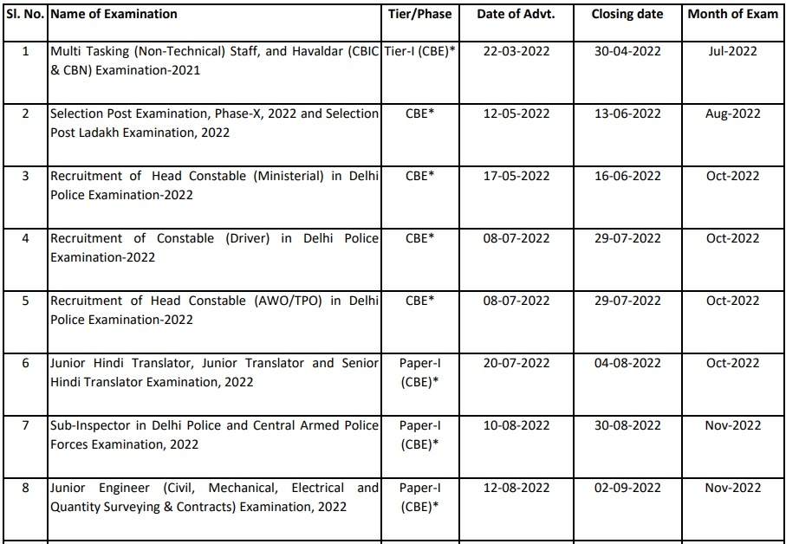
STAFF SELECTION COMMISSION
CALENDAR OF EXAMINATIONS FOR THE YEAR 2022-2023

Slide 17
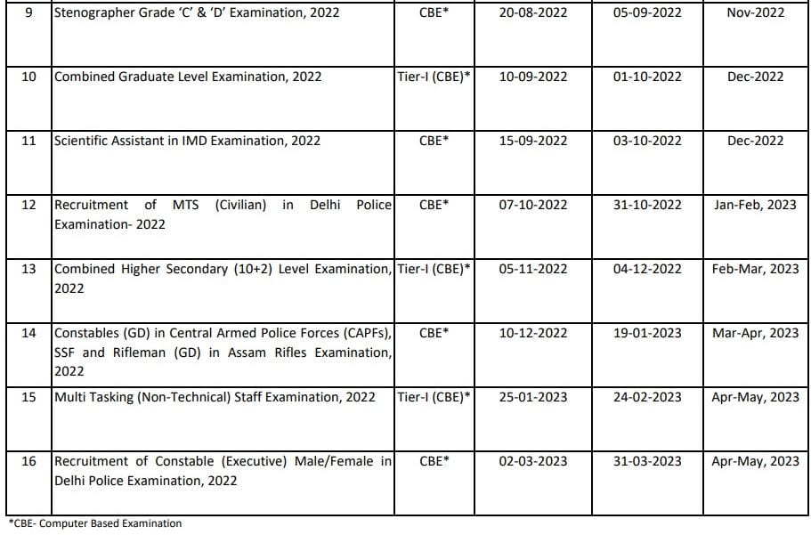
SSC CALENDAR OF EXAMINATIONS FOR THE YEAR 2022-2023

Slide 18
Railway exams
Railway Recruitment Board (RRB)
( https://www.rrbcdg.gov.in/ )
1) RRB Group-D ( https://www.embibe.com/exams/rrb-group-d-eligibility/ )
2) RRB ALP (Assistant Loco Pilot ) ( https://prepp.in/rrb-alp-exam/exam-pattern )
3) DFCCIL (Dedicated Freight Corridor Corporation of India Limited) ( https://prepp.in/dfccil- executive-exam )
4) RRB ASM (Assistant Station Master) ( https://testbook.com/rrb-asm/eligibility-criteria )
5) DRMC CRA (Delhi Metro Rail Corporation-Customer Relation Assistant )
( https://testbook.com/dmrc-cra/eligibility-criteria )
6) RRB JE (Junior Engineer) ( https://testbook.com/rrb-je/exam-pattern )
7) BIS ( Bureau of Indian Standards ) ( https://prepp.in/bis-recruitment-exam )
8) ICAR ( IARI) (Indian Council of Agricultural Research Indian Agricultural Research Institute Technician Exam) ( https://prepp.in/icar-iari-exam )
9) RPF SI (Railway Protection Force-Sub Inspector ) ( https://prepp.in/rpf-si-exam )
10) RPSF (Railway Protection Special Force ) ( https://prepp.in/rpsf-recruitment-exam )
11) RRB NTPC(Non-Technical Popular Categories) ( https://prepp.in/rrb-ntpc-exam/eligibility )
12) RRB Junior Stenographer ( https://prepp.in/rrb-junior-stenographer-exam )
13) RRB Junior Translator ( https://prepp.in/rrb-junior-translator-exam )
14) RPF Constable ( https://prepp.in/rpf-constable-exam )

Slide 19
Exam Name | Age Limit | Educational Qualification | Syllabus | Total Marks | Time (Mins)
RRB Group-D | 18-33 years | Cleared X th standard | Mathematics, General Science, Reasoning, GA/Current Affairs | 100/100 questions | 90
RRB ALP | 18-30 years | Degree/ diploma in engineering ( CE, ME, AE) | Logical reasoning, general intelligence, general awareness, current affairs, mathematics, general science and Engineering | Stage 1-75 Stage 2-175 | 90 120
DFCCIL | 18-30 years | Graduation/ Diploma in in engineering | General Knowledge, General Aptitude/Reasoning, Engineering | 120 | 120
RRB ASM | 18-32 Years | Graduation | Maths, General Intelligence & Reasoning, General Awareness on Current Affairs | 100 | 90
DRMC CRA | 18-30 years | Graduation | General Awareness, Quantitative Aptitude, General Reasoning General English | Stage 1-120 Stage 2-60 | 90 45
RRB JE | 18-33 years | Graduation/ Diploma in in engineering (CE, ME,EEE,AE) | Math, General Intelligence and Reasoning, General Awareness & Science General Awareness ,Physics, Chemistry, Basics of Computer,EVS,PollutionControl, Technical Abilities | Stage 1-100 Stage 2-150 | 90 120

Slide 20
Exam Name | Age Limit | Educational Qualification | Syllabus | Total Marks | Time (Mins)
ICAR (IARI) | 18-30 years | Graduation | General Knowledge, Mathematics, Science, Social Science | 100 | 90
RPF SI | 20-25 years | Graduation | General Awareness, Arithmetic Math, General Intelligence & reasoning | 120 | 90
RPSF | 18-25 years | passed SSC/10th (Constable) Graduation (SI) | Mathematics , General reasoning, General awareness | 120 | 90
RRB- NTPC | 18-33 years | 12th Pass | Mathematics , GI & General reasoning, General awareness | 120 | 90
RRB Junior Stenogr-apher | 18-30 years | 12th Pass | General Awareness, Hindi or English Language Typing – English - 80 wpm in 10 Mins Transcription Time- 50 Mins | 100 | 90
RRB Junior Translator | 18-33 years | Master's Degree | Mathematics, General Intelligence & Reasoning, General Awareness, General Science | 100 | 90

Slide 21
Banking & Insurance Exams
1) IBPS PO ( https://prepp.in/ibps-po-exam/eligibility )
2) IBPS Clerk ( https://prepp.in/ibps-clerk-exam/eligibility )
3) IBPS RRB ( https://prepp.in/ibps-rrb-exam/eligibility )
4) SBI PO ( https://prepp.in/sbi-po-exam/eligibility )
5) SBI Clerk ( https://prepp.in/sbi-clerk-exam/eligibility )
6) IBPS SO ( https://prepp.in/ibps-so-exam/eligibility )
7) NABARD Grade –A Exam ( https://www.anujjindal.in/nabard-grade-a-complete-info/ )
8) RBI Grade B Exam ( https://www.rbi.org.in/ )
9) SEBI Grade A Exam ( https://www.sebi.gov.in/ )
10) UPSC EPFO ( https://prepp.in/upsc-epfo-exam/eligibility )
11) RBI Assistant ( https://prepp.in/rbi-assistant-recruitment-exam/eligibility )
12) NIACL AO ( https://prepp.in/niacl-ao-exam )
( https://www.newindia.co.in/portal/ )
13) IDBI Assistant Manager ( https://prepp.in/idbi-assistant-manager-exam )
14) ESIC MTS ( https://prepp.in/esic-mts-exam )
15) ESIC Stenographer ( https://prepp.in/esic-stenographer-exam )
16) SIDBI Grade A ( https://www.adda247.com/jobs/sidbi-grade-a-recruitment/ )
17) Bank of Baroda PO ( https://prepp.in/bank-of-baroda-po-exam )

Slide 22
Exam Name | Age Limit | Educational Qualification | Syllabus | Total Marks | Time (Mins)
IBPS PO | 20-30 years | Graduation | English , Quant, Reasoning English, DI, Banking & Economic Awareness, Reasoning & Computer Aptitude Interview & GD | 100 200 | 60 180
IBPS Clerk | 20-28 years | Graduation | English , Quant, Reasoning English, Banking & Economic Awareness, Reasoning ,Quant | 100 200 | 60 160
IBPS RRB (Group A&B) | 18-40 years For Scale I II,III,office Assistant | Graduation | Numerical Ability, Reasoning English/Hindi Language* General Awareness, Quant Reasoning & Computer Aptitude | 80 200 | 45 120
SBI Clerk | 20-28 years | Graduation & 50% in Class 10 | English , Quant, Reasoning, Computer English, Banking & General Awareness, Reasoning & Computer Aptitude, Quant | 100 200 | 60 160
SBI PO | 22-30 years | Graduation | English , Quant, Reasoning English, DI, Banking & Economic Awareness, Reasoning & Descriptive English Group Discusssion Interview | 100 250 20 30 | 60 210 - -
IBPS SO | 20-30 years | Graduation | English ,Quant, Reasoning,Banking Awareness English, DI, Banking & Economic Awareness, Reasoning & Computer Aptitude | 125 60 | 120 120

Slide 23

Exam Name | Age Limit | Educational Qualification | Syllabus | Total Marks | Time (Mins)
NABARD Grade –A & B | 21-30 years For grade-A 25-32 years For grade-B | 60% marks in Graduation or Post Graduate degree 60% marks in Post Graduation | Reasoning, English Language, Quant Computer, Decision Making, General awareness, Economic & Social Issues, Agriculture & Rural Development Paper 1: Descriptive English Paper 2: Economic & Social Issues, Agriculture & Rural Development Interview | 200 100 100 50 | 120 90 120 -
RBI Grade B Exam (Max no. of attempt 6 ) | 21-30 years Or 21-32/34 For M.phil/P.hd | atleast 60% marks in Graduation or 55% marks in Post Graduation | Quantitative Aptitude, Reasoning, English, and General Awareness Economic & Social Issues (ESI), Finance & Management (F&M), and English Descriptive papers Interview | 200 300 | 120 330
SEBI Grade A Exam | 20-30 years | Master's Degree in in any discipline | Phase 1-Paper 1: English, Quant, Reasoning , General Awareness Phase 2-Paper 2: English Descriptive Paper 2 for both Phase 1 and Phase 2 Commerce, Accountancy, Management, Finance, Costing, Companies Act, and Economics Interview | 100 100 100 100 - | 100 100 100 100 -

Slide 24

Exam Name | Age Limit | Educational Qualification | Syllabus | Total Marks | Time (Mins)
UPSC EPFO | 21-27 years | Graduation | General English, Indian Freedom Struggle, Current Events and Developmental Issues, Indian Polity & Economy, General Accounting Principles, Industrial Relations & Labour Laws, General Science & Knowledge of Computer applications, General Mental Ability & Quantitative Aptitude, Social Security in India Interview | 300 | 120
RBI Assistant | 20-28 years | Graduation withat least 50% aggregate marks | English, Reasoning ,Numerical Ability English, Reasoning ,Numerical Ability, General Awareness, Computer Knowledge Language Proficiency Test (LPT) | 100 200 | 60 135
NIACL AO | 21-30 years | Graduation/ Master’s With at least 60% aggregate marks | Quant ,English Language, Reasoning, General Awareness Quant ,English Language, Reasoning, General Awareness | 100 200 | 100 150
IDBI Assistant Manager | 21-28 years | Graduation withat least 55% aggregate marks | English Language, Data Interpretation, Logical Reasoning, and Data analysis, Quantitative Aptitude, General Awareness/Economy/Banking Group Discussion Personal Interview | 200 | 120

Slide 25

Exam Name | Age Limit | Educational Qualification | Syllabus | Total Marks | Time (Mins)
ESIC MTS | 18-25 years | Class 10th or equivalent degree | General Intelligence and Reasoning General Awareness Quantitative Aptitude English Comprehension **same syllabus in prelims & Mains | 200 200 | 60 120
ESIC Stenogra-pher | 18-27 years | Passed 12th standard or equivalent degree | English Language and comprehension, Reasoning ability, General Awareness Typing test in English/Hindi | 200 50 | 130 50/65
SIDBI Grade A |  | Bachelor’s Degree in Engineering Or PG in any Subject | Reasoning, English Language, Quantitative Aptitude, General & Banking/Finance Awareness Descriptive Test | 200 50 | 120 60
Bank of Baroda PO | 20-28 years | Graduation or its equivalent Degree with Min 60% aggregate marks | General/Economy/Banking Awareness, Reasoning and Computer Aptitude, Quantitative Aptitude, English Language English Language (Letter Writing & Essay) | 200 50 | 120 30

Slide 26
Banking & Insurance Exams
18) Canara Bank PO ( https://prepp.in/canara-bank-po-exam )
19) EPFO Assistant ( https://prepp.in/epfo-assistant-exam )
20) EPFO SSA ( https://www.adda247.com/epfo-ssa-recruitment.html )
21) IDBI Assistant Manager ( https://www.adda247.com/jobs/idbi-assistant-manager-recruitment-2022 )
22) HARCO Bank Clerk ( https://prepp.in/haryana-harco-bank-exam/eligibility )
23) J&K Bank PO ( https://prepp.in/jk-bank-po-exam/eligibility )
24) Syndicate Bank PO ( https://prepp.in/syndicate-bank-po-exam )
25) LIC HFL ( https://prepp.in/lic-hfl-exam )
26) LIC Assistant ( https://www.adda247.com/jobs/lic-assistant/ )
27) LIC AAO ( https://prepp.in/lic-aao-exam )
28) RBI Office Attendant ( https://prepp.in/rbi-office-attendant-exam )
29) ESIC SSO ( https://www.adda247.com/jobs/esic-sso-recruitmen )
33) IDBI Executive ( https://prepp.in/idbi-executive-exam )
31) Punjab State Co-Operative ( https://byjusexamprep.com/bank-exams/punjab-cooperative-bank-exam-eligibility-criteria )
32) ECGC PO ( https://prepp.in/ecgc-po-exam )
33) LIC ADO ( https://prepp.in/lic-ado-exam/eligibility )
34) RBI Security Guard ( https://prepp.in/rbi-security-guard-exam )
35) NIACL Assistant ( https://prepp.in/niacl-assistant-exam )

Slide 27
State Exams
1) UPSSSC JE Civil ( https://prepp.in/upsssc-junior-engineer-exam )
2) UPSSSC JE Mechanical
( https://testbook.com/upsssc-junior-engineer/eligibility-criteria )
3) WBCS Executive ( https://testbook.com/wbcs/eligibility-criteria ) **
4) UPPCL JE Electrical ( https://prepp.in/uppcl-je-exam )
5) West Bengal Police SI / Kolkata Police SI ( https://testbook.com/wb-police-si/eligibility-criteria )/( https://testbook.com/kolkata-police-si/eligibility-criteria )
6) West Bengal Police Constable / Kolkata Police Constable
( https://testbook.com/wb-police-constable/eligibility-criteria )/
( https://testbook.com/kolkata-police-constable/eligibility-criteria )
7) West Bengal Executive Constable
( https://prepp.in/wb-excise-constable-exam/eligibility )
8) West Bengal Wireless Operator Police
( https://testbook.com/wb-police-wireless-operator )
9) Agragami in WBCEF & WWCD in Civil Defence
( https://www.adda247.com/jobs/wb-police-agragami-recruitment-2021/ )
10) Wireless Supervisor ( Technical) Grate II in WBP Telecommunication
( https://testbook.com/wb-police-wireless-supervisor )
11) Sub-Assistant Engineer ( Civil) & Sub-Assistant Engineer ( Electrical )
( https://testbook.com/wbphidcl-sub-assistant-engineer/eligibility-criteria )
12) WBNVF Agragami in Civil Defence ( https://testbook.com/wb-police-agragami )

Slide 28
13) Delhi Forest Guard ( https://testbook.com/delhi-forest-guard/eligibility )
14) West Bengal Group D ( https://testbook.com/west-bengal-group-d )
15) WBSETCL JE Electrical ( https://testbook.com/wbsetcl-je/eligibility-criteria )
16) Delhi Police Constable ( https://prepp.in/delhi-police-exam/eligibility )
17) Delhi Police Head Constable ( https://prepp.in/delhi-police-head-constable-exam )
18) CRPF SI ( https://testbook.com/crpf-si )
19) WBPSC Food SI ( https://testbook.com/wbpsc-food-si )
20) Jute Corporation of India ( https://www.adda247.com/jobs/jute-corporation-of-india-recruitment/ )
21) Technical Staff under Costal Security ( https://www.indiajoining.com/coastal-security-police-west-bengal/ )
22) WBPSE ( https://wbpsc.gov.in/ ) **

Slide 29


West Bengal Civil Service (Executive) - W.B.C.S. (Exe.) Examinations
( https://wbpsc.gov.in/ )
Qualification : Graduation
Age : Group (A&C) = 21 years , Group B = 20-36 years , Group D = 21-39 years
Preliminary Exam ( Objective Type)
**The duration for the paper will be of 2.5 hours
SL. No. | Compulsory Paper | Marks
1 | English | 25
2 | General Science | 25
3 | Current Events | 25
4 | History of India | 25
5 | Indian Geography (Specially West Bengal) | 25
6 | Indian Polity & Economy | 25
7 | Indian National Movement | 25
8 | General Mental Ability | 25
Total |  | 200

Slide 30
Mains Examinations ( Descriptive & Objective Type)
**The duration for all the papers will be of 3 hours
Paper | Subject (Compulsory Paper) | Marks
Paper -I | Regional Language(Bengali/Hindi/Urdu/Nepali/Santali) | 200
Paper-II | English: Letter writing , Précis Writing | 200
Paper-III | General Studies - I : (i) Indian History (ii) Geography of India | 200
Paper-IV | General Studies-II: Science and Scientific & Technological advancement , Environment General Knowledge , Current Affairs | 200
Paper-V | The Constitution of India and Indian Economy including role and functions of Reserve Bank of India | 200
Paper-VI | Arithmetic & Test of Reasoning | 200
Total Marks |  | 1200
Optional Subjects : Group A + Group B Subjects |  | 400
Interview : i) Group (A&B )=200 marks , ii) Group C = 150 marks , iii) Group D = 100 marks

Slide 31
All Defence Exams
1) AFCAT ( https://prepp.in/afcat-exam/eligibility )
2) CDS ( https://prepp.in/cds-exam/eligibility )
3) NDA ( https://prepp.in/nda-exam/eligibility )
4) Agniveer Navy ( https://www.adda247.com/defence-jobs/agniveer-navy-recruitment-2022/ )
5) Coast Guard Navik ( https://testbook.com/indian-coast-guard-navik-gd/eligibility )
6) SSB ( https://prepp.in/ssb-recruitment-exam )
7) Airforce Group X ( https://prepp.in/iaf-airmen-exam/eligibility )
8) ICG Yantrik Electrical ( https://prepp.in/indian-coast-guard-yantrik-exam )
9) ICG Yantrik Mechanical ( https://prepp.in/indian-coast-guard-yantrik-exam )
10) Territorial Army ( https://prepp.in/territorial-army-exam )
11) Agniveer Army GD ( https://www.adda247.com/defence-jobs/indian-army-agniveer-eligibility-criteria-2022/ )
12) BSF Constable ( https://testbook.com/bsf/eligibility-criteria )
13) CISF Constable Fireman ( https://www.adda247.com/defence-jobs/cisf-fireman-constable-recruitment-2022/ )
14) Assam Rifles Technical ( https://www.adda247.com/defence-jobs/assam-rifles-recruitment-2022 )
15) BSF Radio operator ( https://prepp.in/bsf-ro-exam )
16) Indian Army Soldier Clerk ( https://prepp.in/army-clerk-exam )
17) Indian Army Soldier Technical ( https://prepp.in/indian-army-technical-exam )

Slide 32
18) Indian Army Soldier Tradesman ( https://testbook.com/indian-army-soldier-tradesman/eligibility-criteria )
19) Indian Coast Guard Assistant Commandant ( https://testbook.com/indian-coast-guard-assistant-commandant/eligibility )
20) SSB Head Constable ( https://prepp.in/ssb-head-constable-exam )
21) AFCAT EKT Mechanical ( https://testbook.com/afcat-ekt )
22) Air Force Group C ( https://testbook.com/indian-air-force-group-c/eligibility-criteria )
23) Indian Army B.Sc Nursing ( https://testbook.com/indian-army-bsc-nursing/eligibility-criteria )
24) ISRO Scientific Assistant ( https://testbook.com/isro-scientific-assistant )
25) Army Cadet College ( https://prepp.in/acc-exam/eligibility )
26) Army Havildar SAC ( https://testbook.com/army-havildar-sac/eligibility-criteria )

Slide 33
Teaching Exams
1) UGC NET/JRF /SET ( https://byjusexamprep.com/net-exams/wbset-exam-eligibility ) ( https://prepp.in/cbse-ugc-net-exam/eligibility )
2) CUET ( https://testbook.com/cuet/eligibility-criteria )
3) NTA Delhi University ( https://testbook.com/nta-du-non-teaching/eligibility-criteria )
4) CG TET ( https://prepp.in/cgtet-exam )
5) WB TET ( https://testbook.com/wb-tet/eligibility-criteria )
6) B.Ed Common Entrance ( https://bihar-cetbed-lnmu.in/west-bengal-b-ed-admission )
7) NVS Multi Tasking Staff ( https://testbook.com/nvs-mts/eligibility-criteria )
8) NVS Junior secretariat Assistant ( https://testbook.com/nvs-junior-secretariat-assistant )
9) NVS Catering Assistant ( https://testbook.com/nvs-catering-assistant )
10) WBSSC ( https://prepp.in/wbssc-exam )
12) Central Teacher Eligibility Test (CTET) ( https://ctet.nic.in/ )
Nursing Recruitment
1) AIIMs Nursing Officers ( https://prepp.in/aiims-nursing-officer-exam )
2) NVS Female Staff ( https://testbook.com/nvs-staff-nurse/eligibility-criteria )

Slide 34
Civil Engineering & Mechanical
1) NCRTC Station Controller ( https://prepp.in/ncrtc-station-controller-exam )
2) HPCL Civil Engineer ( https://prepp.in/hpcl-engineer-exam )
3) NHPC JE Civil ( https://prepp.in/nhpc-je-exam )
4) HAL Civil ( https://testbook.com/hal/eligibility-criteria )
5) BPSC Assistant Sanitary ( https://testbook.com/bpsc-asst-sanitary-waste-management-officer/eligibility-criteria )
6) UPSC ESE /IES Exam ( https://www.careerindia.com/upsc/ies-exam-e26.html )
7) ISRO Scientist Civil ( https://www.adda247.com/engineering-jobs/isro-exam-eligibility-criteria/ )
8) CTL MT Civil ( https://testbook.com/cil-mt-ce/eligibility-criteria )
9) DRDO Technician ( https://prepp.in/drdo-technician-a-exam )
10) GATE ( https://engineering.careers360.com/articles/gate-eligibility-criteria )
11) AAE ATC Junior Executive ( https://prepp.in/aai-je-atc-exam )
12) ISRO Technician B ( https://testbook.com/isro-technical-assistant/eligibility-criteria )
13) NTPC Diploma ( https://prepp.in/ntpc-diploma-trainee-exam/eligibility )
14) BHEL Engineer ( https://prepp.in/bhel-engineer-trainee-exam )
Electrical Engineer
1) BSF JE Electrical ( https://www.nvsrobhopal.com/bsf-group-b-je-electrical-si-work-recruitment )
2) WBSETCL JE Electrical ( https://testbook.com/wbsetcl-je/eligibility-criteria )
3) ISRO Scientist Electrical ( https://testbook.com/isro-scientist-ee )

Slide 35
Miscellaneous (Other Engineering Fields)
1) BIS ( https://prepp.in/bis-recruitment-exam )
2) JEE ( https://engineering.careers360.com/articles/jee-main-eligibility-criteria )
3) ICAR (IARI) Assistant ( https://www.adda247.com/jobs/iari-assistant-recruitment/ )
4) ICAR Technician ( https://prepp.in/icar-technician-recruitment-exam )
5) BARC DAE Junior ( https://testbook.com/barc-dae/eligibility-criteria )
6) AAT ATC Junior ( https://prepp.in/aai-je-atc-exam )
7) AAT JE ( https://testbook.com/aai-je-airport-operations/eligibility-criteria )
ITI Exams
1) PSPCL ALM ( https://testbook.com/pspcl-lineman/eligibility-criteria )
2) DRDO Technician ( https://prepp.in/drdo-technician-a-exam )
3) ISRO Technician Electrical ( https://testbook.com/isro-technical-assistant/eligibility-criteria )
4) ISRO Technician B ( https://testbook.com/isro-technical-assistant/eligibility-criteria)
5) NFC-IGCAR Fitter ( https://testbook.com/igcar-stipendiary-trainee/eligibility-criteria)
6) NMDC Maintenance Assistant ( https://testbook.com/nmdc-maintenance-assistant/eligibility-criteria )
7) Northern Coalfields limited Recruitment ( https://prepp.in/northern-coalfields-limited-exam/eligibility )

Slide 36
Miscellaneous
1) IB ACIO II ( https://prepp.in/ib-acio-exam )
2) NBE Junior Assistant ( https://testbook.com/nbe/eligibility-criteria )
3) ASRB AO ( ICAR AO ) ( https://www.oliveboard.in/icar-ao/eligibility )
5) CSIR ( https://www.csir.res.in/ )
6) ICMR Assistant ( https://prepp.in/icmr-assistant-exam )
7) India Post(GDS/BPM) ( https://indiapostgdsonline.gov.in/ )
8) NWDA LDC ( https://prepp.in/nwda-recruitment-exam )
9) NPCIL Plant Operator ( https://prepp.in/npcil-plant-operator-exam/eligibility )
10) NFC Chemical Plant Operator ( https://testbook.com/nfc-chemical-plant-operator/eligibility-criteria )
11) RSMSSB JE ( https://prepp.in/rsmssb-junior-engineer-exam/eligibility )

Slide 37

Master of Business Administration (MBA)
**MBA is one of the most popular post-graduate
courses in India and abroad .
Popular MBA entrance exams :-
1) National-Level Test conducted by an apex testing body or a top national B- school on behalf of the other participating colleges. Eg: CAT, MAT, CMAT or ATMA.
2) State-Level Test conducted by a state level testing body or a top state B-school on behalf of the other participating colleges in that state. Eg: MAH-CET, OJEE, KMAT, TANCET or APICET.
3) Institute-Level Test conducted for admission to its own MBA Programme. In some cases, these scores can be accepted as a qualifying criteria by other B-schools as well. Eg: XAT, NMAT, SNAP, IBSAT.
4) Test conducted by a university for admission to MBA Programmes being offered by colleges that are affiliated to it. Eg: KIITEE, LUMET, HPU MAT.

Slide 38
Common Admission Test (CAT) Exam
( https://iimcat.ac.in/ )
** The IIMs (Indian Institute of Management) conduct this Common Admission Test on a rotational basis.
** CAT Exam Fees : INR 1100 (Reserved categories)
INR 2200 (Other categories)
** The MBA fee generally ranges between INR 10-25 lakh depending on college to college but FMS Delhi takes lower course fee such as approximately Rs 10,480 per year
** Eligibility : Bachelor’s degree with 50% aggregate(45% aggregate or equivalent for reserved categories)
Time (Mins) | Syllabus | Total Questions | Total Marks
120 CBT mode | Verbal ability and Reading comprehension Data Interpretation and Logical reasoning Quantitative Ability | 64-76 | 192-228
** After qualify CAT exam on the basis of the Interview process candidates get selected into different IIMs **Personality assessment test round (Group Discussion or GD, Written Ability Test or WAT and Personal Interview or PI)

Slide 39
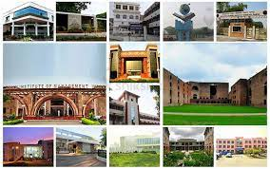

TOP 20 IIMs
( https://en.wikipedia.org/wiki/Indian_Institutes_of_Management )
SL. NO. | Name | Course Offered | Duration
1 | IIM Ahmedabad | PGP, PGPX/EPGP, FPM, AFP, PGP-FABM, ePGP, FDP | 2y, 1y, 5y, 6 month, 2y, 2-3y,
2 | IIM Bangalore | PGP, PGPX/ EPGP, FPM, PGPPM ,PGPEM | 2y, 1y, 5y, 1y, 2y
3 | IIM Calcutta | PGP, PGPEX, FPM, PGPEX-VLM, PGBDA, CEMS- MIM | 2y, 1y, 5y, 1y, 2y, 1y
4 | IIM Lucknow | PGP, FPM, EFPM, PGPABM, PGPSM, WPM, IPMX | 2y, 5y, 4y, 2y, 2y, 3y, 1y
5 | IIM Kozhikode | PGP, EPGP, PGPBL, FPM, | 2y, 2y, 1y, 5y,
6 | IIM Raipur | PGP, PGPWE, FPM, EFPM | 2y, 1.5y, 5y, 4y
7 | IIM Shillong | PGP, PGPEx-MBIC , FPM | 2y, 14 months,5y
8 | IIM Indore | PGP, EPGP, FPM, IPM, PGP-Mumbai, PGPMX, PGPHRM | 2y, 1y, 5y, 5y, 2y, 2y, 2y

Slide 40
( https://www.shiksha.com/mba/articles/mba-courses-offered-by-iims-blogId-19127 )
SL. NO | Name | Course Offered | Duration
9 | IIM Ranchi | PGDM, PGEPX, FPM, PGPEM, PGDHRM, CPGM | 2y, 1y, 5y, 2y, 2y, 15 months
10 | IIM Rohtak | PGPM, EPGP, FPM | 2y, 1y, 5y
11 | IIM Kashipur | PGP, EPGP, FPM, EFPM | 2y, 1y, 5y, 4y
12 | IIM Tiruchirappalli | PGPM, FPM, PGPBM | 2y, 5y, 24 months
13 | IIM Udaipur | PGP, PGPX, FPM, MDPWE | 2y, 1y, 5y, 5 months
14 | IIM Amritsar | PGP | 2y
15 | IIM Bodh Gaya | PGDM | 2y
16 | IIM Nagpur | PGP | 2y
17 | IIM Sambalpur | PGP | 2y
18 | IIM Sirmaur | PGPM | 2y
19 | IIM Visakhapatnam | PGP, PGCP-BMEP | 2y, 15 months
20 | IIM Jammu | PGP | 2y
21 | ** FMS Delhi | MBA/PGDM, Executive MBA/PGDM, P.hD | 2y, 2y, 5y

Slide 41
COURSE NAME
1) Post Graduate Programme in Management (PGP)
2) Post Graduate Programme in Management for Executives (PGPX) /
Executive Post Graduate Programme in Management (EPGP)
3) Fellow Programme in Management (FPM)
4) Armed Forces Programme in Business Management (AFP)
5) Post Graduate Programme in Food and Agri-business Management (PGP- FABM)
6) ePost Graduate Programme (ePGP)
7) Faculty Development Programme (FDP)
8) Post- Graduate Program in Public Policy and Management (PGPPM)
9) Post- Graduate Programme in Enterprise Management (PGPEM)
10) PGPEX-VLM (Post Graduate Program for Executives for Visionary Leadership in
Manufacturing)
11) Post Graduate Diploma in Business Analytics (PGDBA)
12) CEMS MIM: Master’s in International Management
13) Post Graduate Programme in Business Leadership (PGP-BL)
14) Post Graduate Diploma in Management (PGDM)
15) Post Graduate Programme in Management for Executives (PGEXP)

Slide 42
COURSE NAME
16) Post Graduate Diploma in Human Resource Management (PGDHRM)
17) Certificate Program in General Management (CPGM)
18) MDP for Women Entrepreneurs (MDPWE)
19) Post Graduate Programme in Management Mumbai (PGP- Mumbai)
20) Post Graduate Diploma Programme in Management for Executives (Modular)-
PGPMX- offered in Mumbai
21) Post Graduate Programme in Human Resource Management (PGP-HRM)
22) Executive Fellow Programme in Management (EFPM)
23) Post Graduate Programme in Agri-business Management (PGP- ABM)
24) Post- Graduate Programme in Sustainable Management (PGP- SM)
25) Post-Graduate Programme in Management for Working Executives (WPM)
26) Management for Executives (IPMX)
27) Post Graduate Programme in Management for Working Executive (PGPWE)
28) Post Graduate Program for Executives - Managing Business in India and China
(PGPEx- MBIC)
29) Post Graduate Programme in Business Management (PGPBM)
30) Post Graduate Certificate Programme in Business Management for
Experienced Professionals ( PGCP-BMEP )

Slide 43
Some Facts
1. There are 20 IIMs all run a PhD program.
2. CAT is not a mandatory requirement for a PhD from IIM.
3. IIMs can also award a PhD degree.
4. B.Tech & similar 4/5 year graduates are eligible.
5. CA, CS & even students from Integrated UG & PG programme can apply to IIM.
6. Students pursuing their qualifying degree can apply to the PhD programme of IIM.
7. Students from all and any stream can apply to the PhD Programme of IIM.
8. There is no fee for the full-time PhD Programme at IIM.
9. A monthly fellowship (stipend) is given to all Full-time PhD scholars.
10) Except CAT through some other exams like UGC-NET, CSIR-UGC NET, GATE students
can apply for P.hD in various IIMs.
MBA Abroad
To pursue MBA abroad, candidates have to prepare for Graduate Management Aptitude Test (GMAT) and language proficiency tests Test of English as a Foreign Language (TOEFL) and International English Language Testing System (IELTS) for MBA abroad admission.
Academic qualification for MBA abroad is same as that of domestic programmes, i.e. 50 per cent aggregate in graduation or equivalent from a recognised university. Work experience of three to five years is required for most of the MBA courses abroad.

